Slide 1

2022 Uganda P2-ZOI Midline Survey GIS Training Workshop
March 2024/Kampala, Uganda/2022 Uganda P2-ZOI Midline Survey GIS Training Workshop/Prepared by Blue Raster on behalf of ICF
Photo credit: PLACEHOLDER

Slide 2
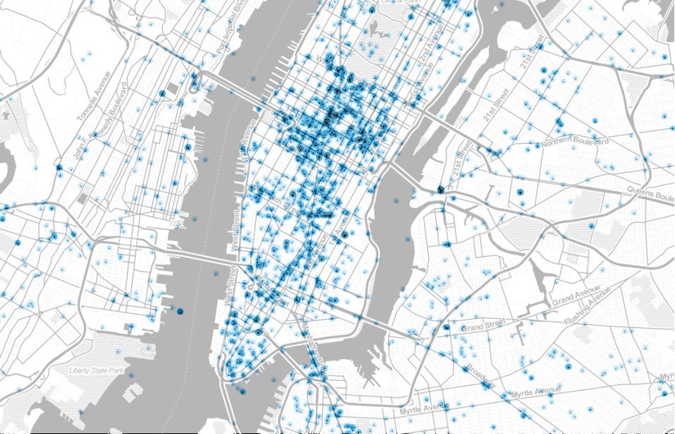
Introduction to Geographic Information Systems
What is GIS?
History
Purpose
Role
Impact

Slide 3
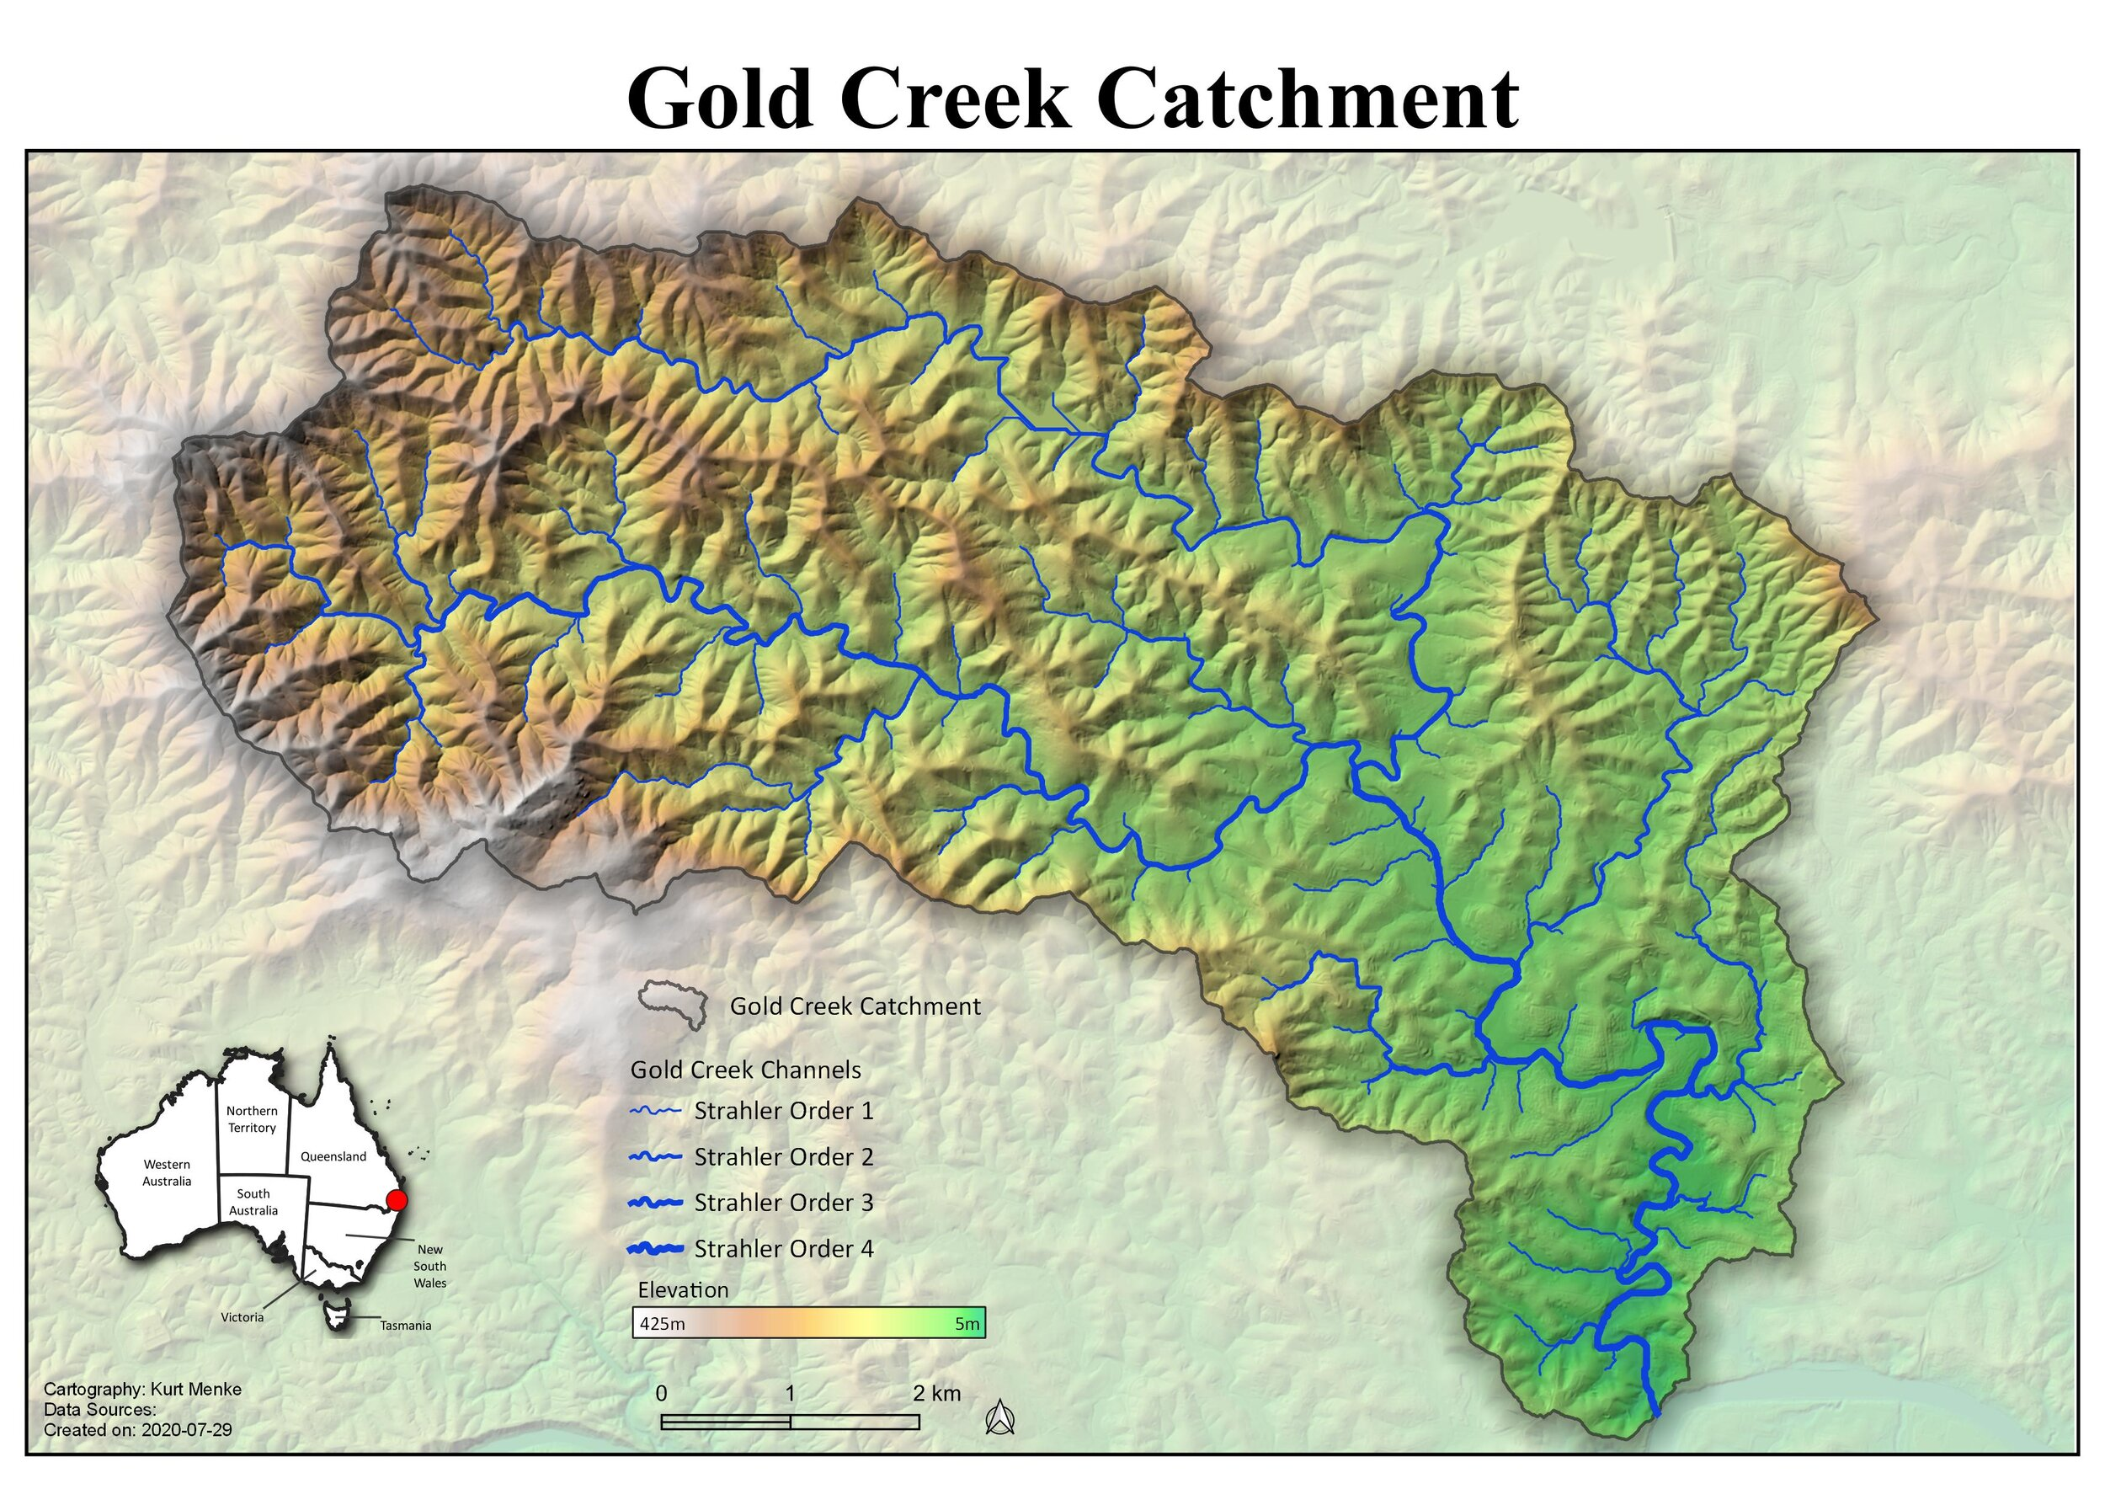
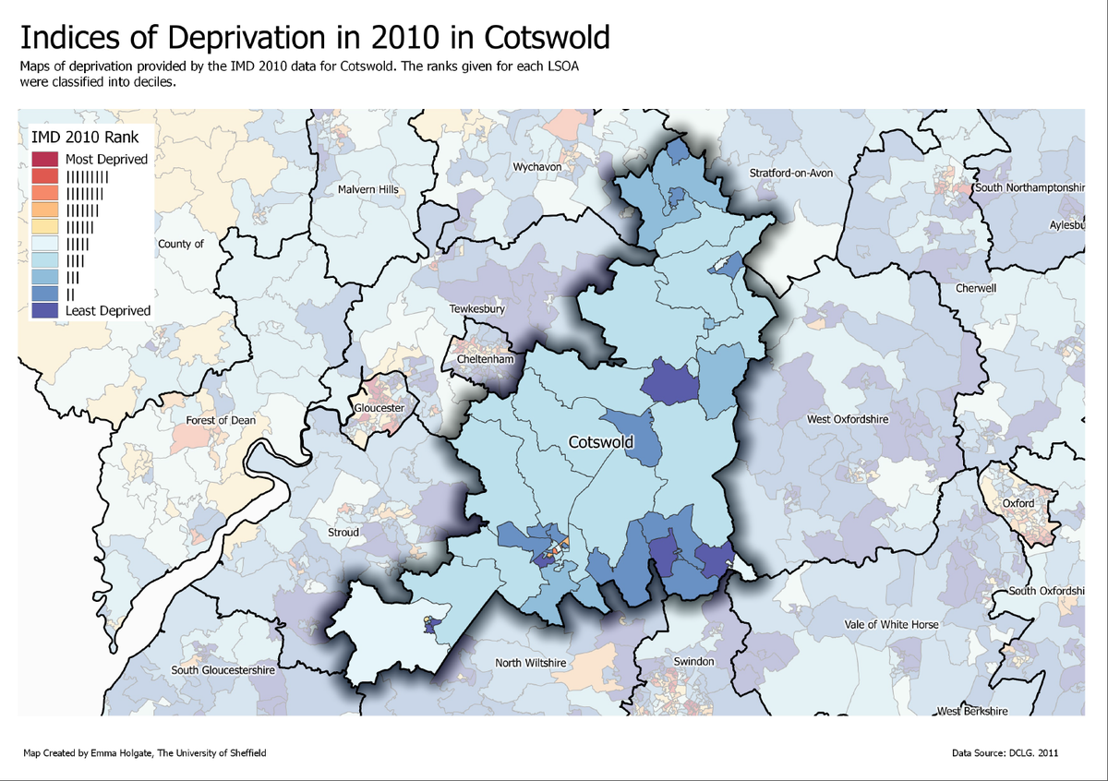
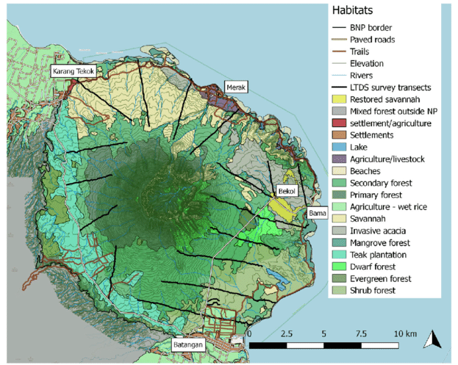
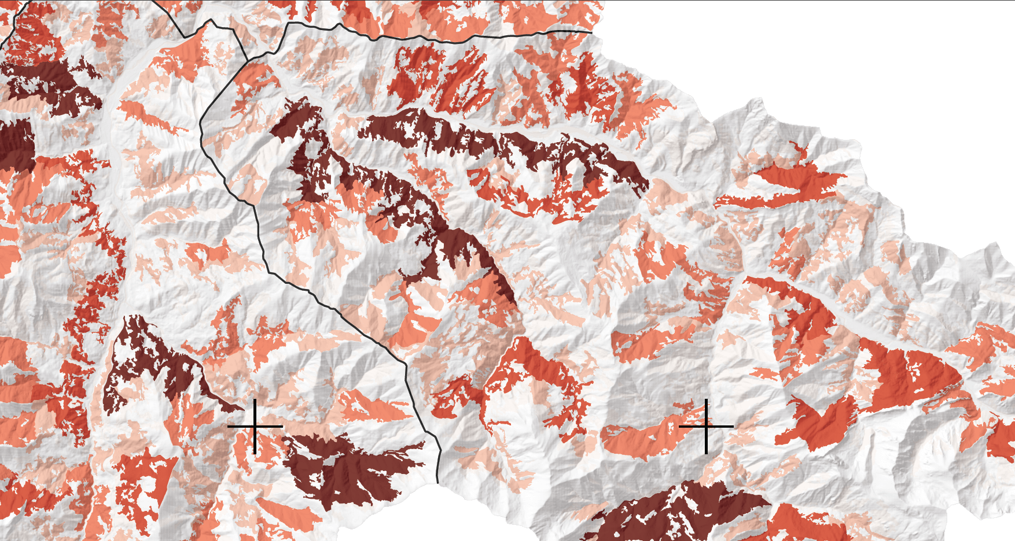
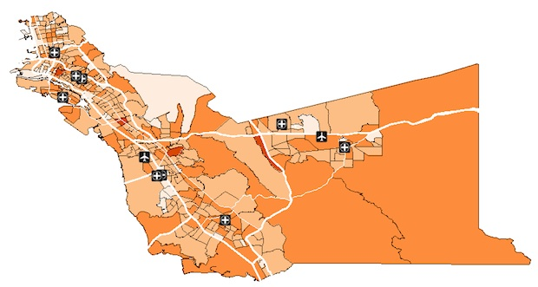
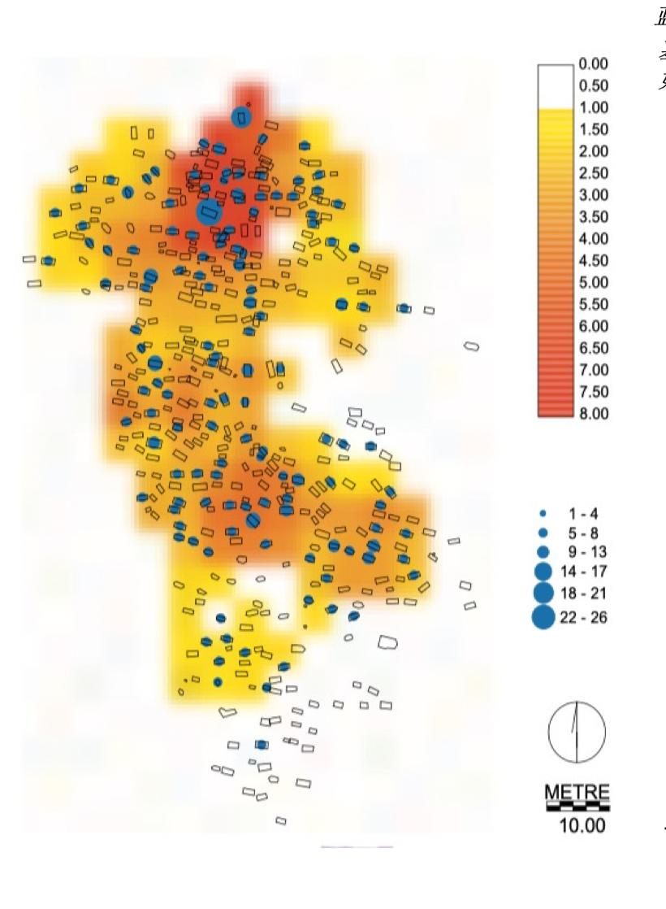
What is GIS?
Geographic Information Systems – designed to capture, store, manipulate, analyze, manage, and present spatial or geographic data.
Notes:
### Introduction to Geographic Information Systems (GIS)
- Define GIS as a framework for gathering, managing, and analyzing data rooted in the science of geography.
- Highlight the importance of GIS in decision-making processes across various industries, including urban planning, environmental management, public health, and more.
### Layers on Layers on Layers
- Explain how GIS operates on the principle of layering data; each layer corresponds to a different type of information (e.g., roads, water bodies, population density).
- Use visuals to demonstrate how these layers can be combined to reveal patterns, relationships, and trends.
### Points, Lines, Polygons
- Dive into the basic elements of GIS data:
- **Points**: Represent specific locations, such as businesses or sensor data points.
- **Lines**: Used to represent linear features, like rivers, roads, or railway tracks.
- **Polygons**: Define areas such as city boundaries, land use zones, or lake perimeters.
- Provide examples of how each element is used in practical applications.
### System of Record, Insight, Engagement
- **System of Record**: Discuss how GIS serves as a comprehensive database for spatial data, documenting the geography of where infrastructure and assets are located.
- **System of Insight**: Explain how GIS analyzes spatial data to uncover hidden patterns, make predictions, and support strategic decisions.
- **System of Engagement**: Highlight GIS as a platform for collaboration and engagement, enabling communities and organizations to interact with and contribute to spatial data.
### Early Maps and Antiquities
- Briefly explore the history of mapping and cartography, emphasizing how early maps were the precursors to modern GIS.
- Mention significant advancements in early cartography and the role of maps in navigation and exploration.
### John Snow - Cholera in London
- Tell the story of John Snow's pioneering work in 1854, using a map to identify the source of a cholera outbreak in London.
- Discuss how Snow's work is considered one of the earliest examples of using spatial analysis to solve public health problems.
### Modern GIS
- Outline the evolution of GIS from desktop applications to the integration of mobile and web-based platforms.
- **Desktop GIS**: Focus on the comprehensive analysis and editing capabilities for professionals.
- **Mobile GIS**: Highlight the importance of field data collection and real-time location tracking.
- **Web GIS**: Discuss the accessibility and collaborative aspects, allowing users to share and interact with spatial data online.
### Conclusion
- Emphasize the transformative impact of GIS on understanding and solving complex problems by integrating geographical data with analytical tools.
- Inspire your audience by discussing the future potential of GIS technology, including advancements in AI, machine learning, and the increasing availability of real-time data.

Slide 4
History of GIS
1854: John Snow's Cholera Map
1960s: Emergence of GIS
1970s: Expansion of GIS Applications
1980s: Introduction of Desktop GIS
1990s: Integration of GPS
2000s: Web-based GIS
2010s-Present: Big Data and Real-time Analytics
Notes:
1854: John Snow's Cholera Map - Pioneering use of spatial analysis to identify the source of a cholera outbreak in London, highlighting the power of mapping in public health.
1960s: Emergence of GIS - Development of the first true GIS in Canada as part of the Canada Geographic Information System (CGIS), aimed at inventorying natural resources.
1970s: Expansion of GIS Applications - GIS technology begins to spread globally, with uses expanding beyond natural resources to urban planning and environmental management.
1980s: Introduction of Desktop GIS - The advent of personal computers allows GIS software to become more accessible to individuals and smaller organizations.
1990s: Integration of GPS - The integration of Global Positioning System (GPS) data with GIS enhances the accuracy and utility of spatial analyses.
2000s: Web-based GIS - The launch of web-based GIS applications, such as Google Earth, makes geographic information available to a broad public audience.
2010s-Present: Big Data and Real-time Analytics - Advances in computing power and the advent of big data analytics enable real-time GIS analysis and visualization, supporting applications ranging from disaster response to autonomous driving.

Slide 5
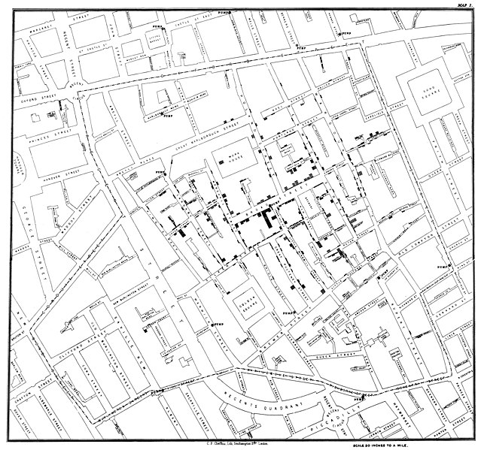
History of GIS
John Snow – Mapping a Cholera Outbreak in London (1854)
Notes:
1854: John Snow's Cholera Map - Pioneering use of spatial analysis to identify the source of a cholera outbreak in London, highlighting the power of mapping in public health.
1960s: Emergence of GIS - Development of the first true GIS in Canada as part of the Canada Geographic Information System (CGIS), aimed at inventorying natural resources.
1970s: Expansion of GIS Applications - GIS technology begins to spread globally, with uses expanding beyond natural resources to urban planning and environmental management.
1980s: Introduction of Desktop GIS - The advent of personal computers allows GIS software to become more accessible to individuals and smaller organizations.
1990s: Integration of GPS - The integration of Global Positioning System (GPS) data with GIS enhances the accuracy and utility of spatial analyses.
2000s: Web-based GIS - The launch of web-based GIS applications, such as Google Earth, makes geographic information available to a broad public audience.
2010s-Present: Big Data and Real-time Analytics - Advances in computing power and the advent of big data analytics enable real-time GIS analysis and visualization, supporting applications ranging from disaster response to autonomous driving.

Slide 6









Purpose of GIS
System of Record
System of Insight
System of Engagement
Notes:
System of record
What information and data is stored in the map?
Maps of the past, present, and future
System of Insight
What’s the takeaway from a map? Can you get what the map is saying to you?
System of Engagement
What is the story we are telling?
Is there any bias?
How do I lie with a map? How do I tell a joke with a map?

Slide 7

Role of GIS
Understand our environment
Collect data in the field
Create snapshots of time
Manage data
Understand spatial patterns
Monitor progress
Analyze data
Communicate results
Notes:
Geographic Information Systems (GIS) serve as a pivotal tool for managing and analyzing data, enabling us to collect valuable insights directly from the field and create detailed snapshots of time. Through the power of GIS, we can gain a deeper understanding of the environment, uncover spatial patterns, and monitor progress over time, transforming complex data into comprehensible, actionable knowledge. Moreover, GIS facilitates the effective communication of results, allowing us to share findings with stakeholders and the public in a visually engaging and easily understandable manner, thereby enhancing decision-making and policy development.
Talk about Uganda survey.

Slide 8
Impact of GIS
Enhances Storytelling - Transforms complex spatial data into engaging narratives and visualizations.
Forecasts Future Trends - Utilizes data to predict and model future environmental, urban, and social changes.
Unravels Historical Insights - Analyzes spatial patterns to understand and visualize historical events and evolutions.
Facilitates Data-Driven Decisions - Empowers decision-makers by crunching numbers and identifying trends for informed planning and policy-making.
Notes:
Geographic Information Systems (GIS) have revolutionized the way we interpret and interact with the world around us, profoundly impacting various aspects of society, science, and decision-making.
By enabling storytelling through spatial visualization, GIS helps convey complex phenomena and narratives in a manner that is both engaging and accessible, allowing for a deeper connection with the subject matter.
Predicting and modeling the future become more feasible and accurate with GIS, as it integrates vast datasets to forecast environmental changes, urban growth, and potential impacts of policy decisions, helping planners and policymakers to prepare more effectively for what lies ahead.
Understanding the past is also enhanced through GIS by providing tools to analyze historical landscapes, migration patterns, and changes over time, offering insights into historical events and trends.
Furthermore, GIS is pivotal in crunching numbers and making informed decisions, as it allows for the analysis of spatial data to identify trends, patterns, and anomalies, supporting everything from resource management to emergency response planning. The impact of GIS is thus far-reaching, transforming data into actionable intelligence that drives better decisions and outcomes.

Slide 9
Discussion – What do you think of gis?
Example questions:
“Could you explain to someone what GIS is used for?”
“Do you have any examples of the impact of GIS?”
“What is the current role of GIS in your organization?”
“Do you see opportunities to improve a process using GIS?”
Notes:
5 mins to talk through everyone’s understanding and what they think GIS is after these intro slides, before going into the data conversation

Slide 10
Live Demo

Slide 11
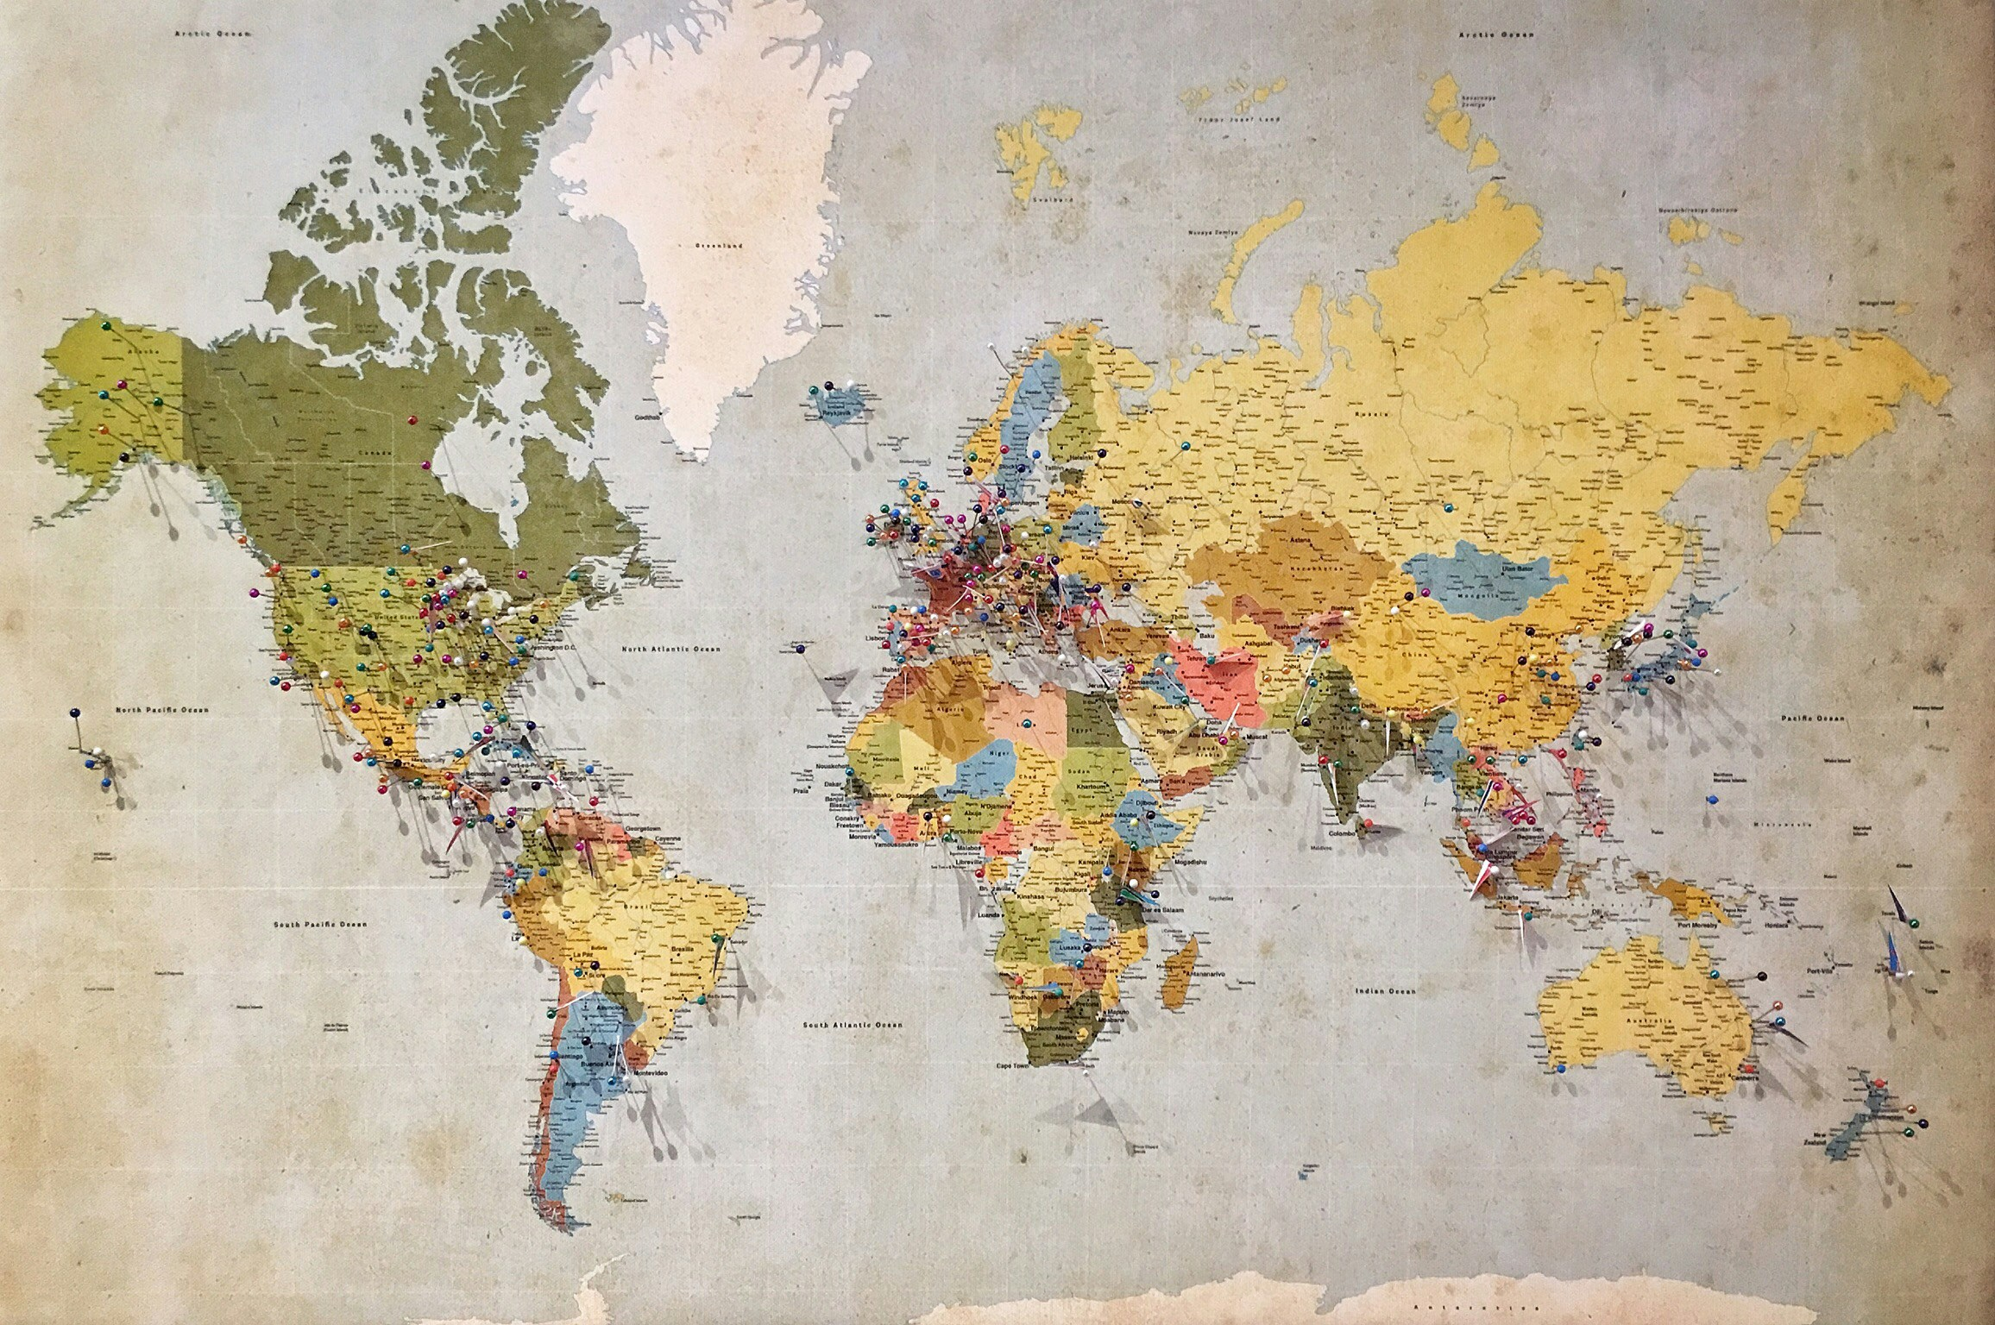
Finding and Preparing data for gis
Data vs Information
GIS Data Types, Formats, and Sources
Finding and Preparing Data for GIS
Common Challenges & Solutions

Slide 12
Data vs Information
Data
Information
Notes:
What is Data? - Raw, unprocessed facts and figures without context, like numbers, measurements, or observations.
What is Information? - Data that has been processed, organized, or presented with context to make it meaningful and useful.
Difference Between Data and Information - Information is derived from data; it's what you get when data is interpreted and given meaning through analysis.
Turning Data into Information - Involves processing and analyzing data to extract insights or knowledge that informs decisions or understanding.
Spatially Enabling Data - Refers to adding geographical identifiers to data, such as coordinates or addresses, making it possible to map and analyze in a GIS.
How Spatial Data Differs - Spatial data is enhanced with geographical information, allowing for the visualization and analysis of data in relation to its location on the Earth's surface.

Slide 13
Data vs Information
Lacks context and interpretation.
Can be quantitative or qualitative.
Processed, organized, and contextualized data.
Provides insights and supports decision-making.
Often presented in the form of reports, visualizations, or analyses
Serves as a foundational layer for all subsequent analysis and interpretation.
Raw, unprocessed facts and figures.
Data
Information
Notes:
What is Data? - Raw, unprocessed facts and figures without context, like numbers, measurements, or observations.
What is Information? - Data that has been processed, organized, or presented with context to make it meaningful and useful.
Difference Between Data and Information - Information is derived from data; it's what you get when data is interpreted and given meaning through analysis.
Turning Data into Information - Involves processing and analyzing data to extract insights or knowledge that informs decisions or understanding.
Spatially Enabling Data - Refers to adding geographical identifiers to data, such as coordinates or addresses, making it possible to map and analyze in a GIS.
How Spatial Data Differs - Spatial data is enhanced with geographical information, allowing for the visualization and analysis of data in relation to its location on the Earth's surface.

Slide 14
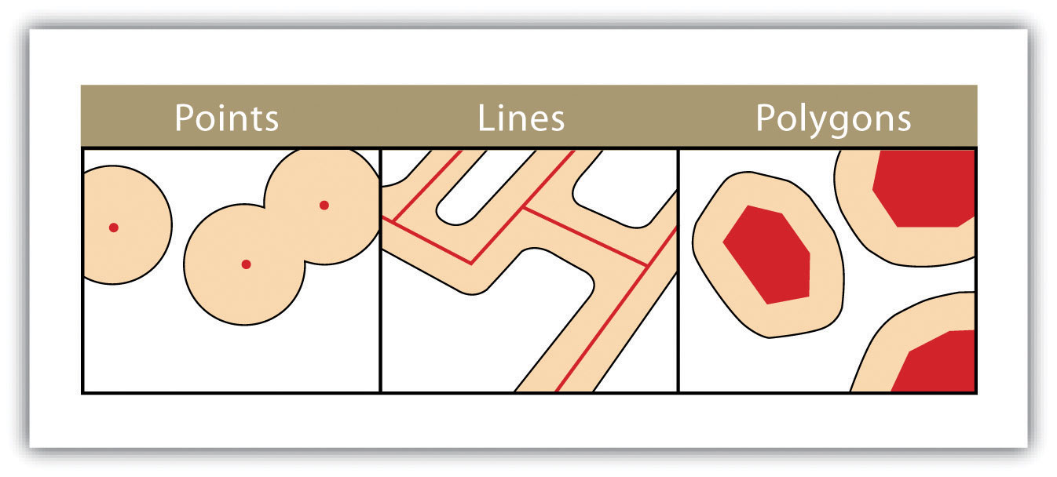
Data in GIS
Data Geometries:
Points: Represent specific locations or entities on the map (e.g., wells, landmarks).
Lines: Used to depict linear features such as roads, rivers, or utility lines.
Polygons: Define areas like lakes, city boundaries, or land use zones.
Data Format Types:
Numeric Types: Include integers (Long) and floating-point numbers (Double) for quantitative attributes.
Temporal Types: Date formats to capture time-related aspects of data.
Textual Types: String for descriptive attributes, names, or categories.
Notes:
Data Geometries in GIS:
Points: Represent specific locations or entities on the map (e.g., wells, landmarks).
Lines: Used to depict linear features such as roads, rivers, or utility lines.
Polygons: Define areas like lakes, city boundaries, or land use zones.
Data Format Types:
Numeric Types: Include integers (Long) and floating-point numbers (Double) for quantitative attributes.
Temporal Types: Date formats to capture time-related aspects of data.
Textual Types: String for descriptive attributes, names, or categories.

Slide 15
Data in GIS
Data Sources for GIS:
Structured Files: Common formats include CSV (Comma Separated Values), XLSX (Excel Spreadsheet), and DBF (Database File).
Geospatial Formats: GDB (Geodatabase) for complex datasets, Shapefiles for vector data, and REST endpoints for accessing web services.
Open Data Sources:
International and National Organizations: Provide datasets for global and regional analysis.
Governments: Offer public access to a wide range of spatial data including census, environmental, and urban planning data.
NPOs/NGOs: Contribute data focusing on social, environmental, and humanitarian issues.
DHS (Demographic and Health Surveys): Source of detailed population and health data in over 90 countries.
Notes:
Data Sources for GIS:
Structured Files: Common formats include CSV (Comma Separated Values), XLSX (Excel Spreadsheet), and DBF (Database File).
Geospatial Formats: GDB (Geodatabase) for complex datasets, Shapefiles for vector data, and REST endpoints for accessing web services.
Open Data Sources:
International and National Organizations: Provide datasets for global and regional analysis.
Governments: Offer public access to a wide range of spatial data including census, environmental, and urban planning data.
NPOs/NGOs: Contribute data focusing on social, environmental, and humanitarian issues.
DHS (Demographic and Health Surveys): Source of detailed population and health data in over 90 countries.

Slide 16

Finding Data
Open-Source
Proprietary
Field Data Collection
Local vs Global Data
Spatial Resolution
QA/QC
Notes:
Open-Source Data:
Freely available datasets from government, international organizations, and academic institutions.
Includes geographical, environmental, demographic, and socio-economic datasets.
Proprietary Data:
Owned by companies or entities with restrictions on use and distribution.
Often more specialized or detailed, requiring purchase or subscription.
Field Data Collection:
Gathering data directly from the environment using GPS devices, sensors, or manual surveying.
Provides highly specific and current data for targeted locations or projects.
Local vs Global Data:
Local Data: Focused on specific regions or communities, offering detailed insights into smaller areas.
Global Data: Covers broad geographic areas, useful for international studies or comparative analyses.
Resolution of Data:
Refers to the detail and precision of data, impacting its analysis and interpretation.
High-resolution data offers finer detail but requires more storage and processing power.
QA/QC Data (Quality Assurance/Quality Control):
Practices and procedures to ensure data integrity and accuracy.
Essential for reliable GIS analysis, involving error checking, validation, and correction processes.

Slide 17
Preparing Data for GIS
Understanding what we have available and what we need
What question are we trying to answer?
Is anything missing from our data?
What’s the resolution of our data?
Understanding Projections and Coordinate Systems
Notes:
When preparing data for Geographic Information Systems (GIS), it's crucial to have a structured approach to ensure the data is fit for purpose and can accurately answer the questions at hand.
Understanding Available Data and Needs
Identifying Available Resources: Begin by taking stock of all available data, noting formats, sources, and any associated metadata.
Defining Requirements: Clearly outline what you aim to achieve with your GIS project. This step helps in identifying any gaps between what data you have and what you need.
Addressing the Question: Tailor your data collection and preparation efforts to directly address the core questions or objectives of your project. This focus ensures relevancy and efficiency in data use.
Assessing Data Completeness and Suitability
Gap Analysis: Compare your current data inventory against project needs to identify missing elements. This may involve spatial, temporal, or attribute data that is crucial for analysis.
Data Resolution: Evaluate the resolution of your data to ensure it matches the scale of analysis. High-resolution data is necessary for detailed site-specific studies, while lower resolution may suffice for broader, regional analyses.
Understanding Projections and Coordinate Systems
Importance of Projections: Projections transform the three-dimensional earth into a two-dimensional map, a process that can distort spatial relationships if not managed correctly.
Choosing the Right Projection: The choice of projection and coordinate system should align with the region of interest and the analysis goals. Different projections are optimized for different purposes, such as minimizing area, distance, or directional distortions.
Coordinate Systems: Understanding and correctly applying coordinate systems is fundamental to ensuring spatial accuracy and interoperability of GIS data. This involves using standardized systems like WGS 84 for global datasets or more localized systems for regional studies.
Preparing Data for Analysis
Data Cleaning and Formatting: Standardize data formats, clean any errors or inconsistencies, and ensure all datasets are compatible in terms of projections and units of measurement.
Integration and Consolidation: Combine datasets from different sources into a cohesive GIS database, paying attention to maintaining spatial integrity and attribute accuracy.

Slide 18
Common challenges and solutions
Missing Metadata
Impact: Metadata provides essential context about data, including how, when, and by whom it was collected, its format, and its intended use case. Missing metadata can severely limit the ability to assess data quality and applicability.
Solutions: When possible, backtrack to original data sources to retrieve or reconstruct metadata. Going forward, establish protocols to ensure comprehensive metadata is collected and maintained alongside the data.
Null Data
Impact: Null values can signify missing, undefined, or inapplicable data points, which might skew analysis or lead to inaccurate conclusions.
Solutions: Strategies include data imputation (estimating missing values based on other data), excluding nulls from analysis where appropriate, or analyzing the pattern of nulls for insights into data quality or collection methods.
Poor Documentation and Miscommunication
Impact: Insufficient documentation of data sources, collection methods, and analysis processes can lead to confusion, errors in data interpretation, and challenges in project replication or continuation.
Solutions: Maintain detailed documentation of all aspects of your GIS project, including data sources, methodology, and any issues encountered. Foster open communication within your team and with stakeholders, using simple, clear language to ensure understanding across diverse audiences.
Notes:
Null Data
Impact: Null values can signify missing, undefined, or inapplicable data points, which might skew analysis or lead to inaccurate conclusions.
Solutions: Strategies include data imputation (estimating missing values based on other data), excluding nulls from analysis where appropriate, or analyzing the pattern of nulls for insights into data quality or collection methods.
Latitude/Longitude Mislabeling
Impact: Incorrectly labeled or inaccurately recorded latitude and longitude data can lead to significant errors in spatial analysis, misplacing features on the map.
Solutions: Implement rigorous QA (Quality Assurance) and QC (Quality Control) protocols during data collection and entry. Use automated tools to validate geographic coordinates against known locations or reference datasets.
Poor Documentation and Miscommunication
Impact: Insufficient documentation of data sources, collection methods, and analysis processes can lead to confusion, errors in data interpretation, and challenges in project replication or continuation.
Solutions: Maintain detailed documentation of all aspects of your GIS project, including data sources, methodology, and any issues encountered. Foster open communication within your team and with stakeholders, using simple, clear language to ensure understanding across diverse audiences.
Missing Metadata
Impact: Metadata provides essential context about data, including how, when, and by whom it was collected, its format, and its intended use case. Missing metadata can severely limit the ability to assess data quality and applicability.
Solutions: When possible, backtrack to original data sources to retrieve or reconstruct metadata. Going forward, establish protocols to ensure comprehensive metadata is collected and maintained alongside the data.
Additional Considerations
Data Overload: The sheer volume of available geospatial data can be overwhelming, making it difficult to identify and utilize the most relevant datasets.
Solution: Develop clear criteria for data selection based on your project goals and constraints, focusing on quality and relevance over quantity.
Interoperability Issues: Differences in data formats, standards, and coordinate systems can complicate the integration of datasets from various sources.
Solution: Use GIS software and tools capable of converting and harmonizing disparate data formats and coordinate systems, ensuring seamless data integration.
Privacy and Ethical Concerns: Geospatial data can sometimes include sensitive or personally identifiable information, raising privacy and ethical issues.
Solution: Adhere to legal guidelines and ethical standards for data use, applying anonymization techniques where necessary and ensuring data use complies with privacy regulations.
By recognizing and addressing these challenges with thoughtful strategies and best practices, you can enhance the quality, reliability, and impact of your geospatial data analysis.

Slide 19
Live Demo

Slide 20
Visualizing and Editing Spatial Data
Visualizing and Mapping the data
QA/QC
View Tabular Data
Editing Spatial Data
Improving Symbology

Slide 21
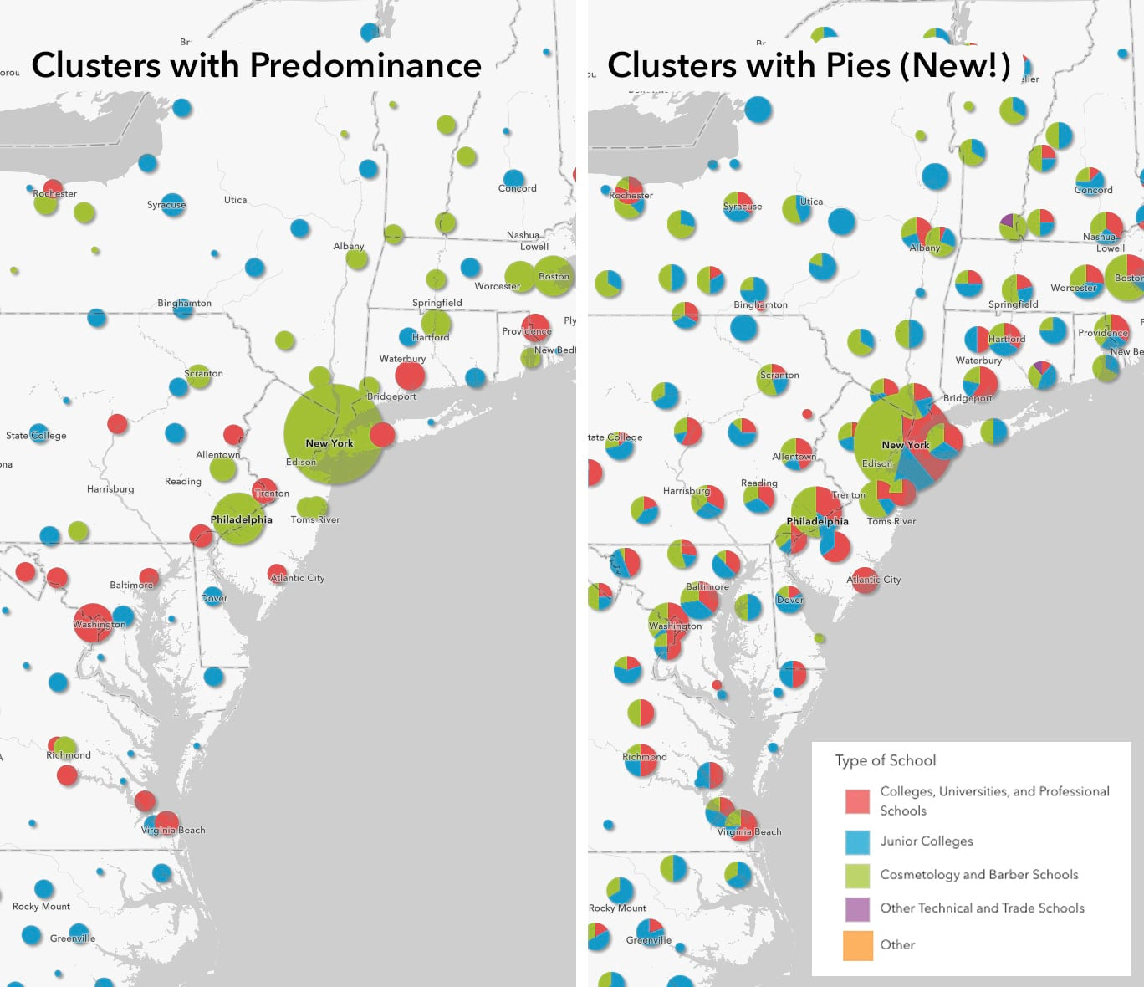
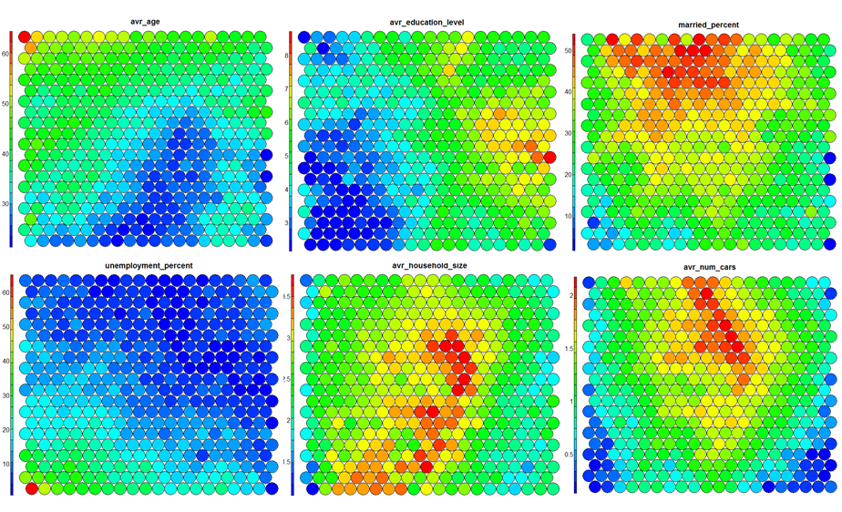
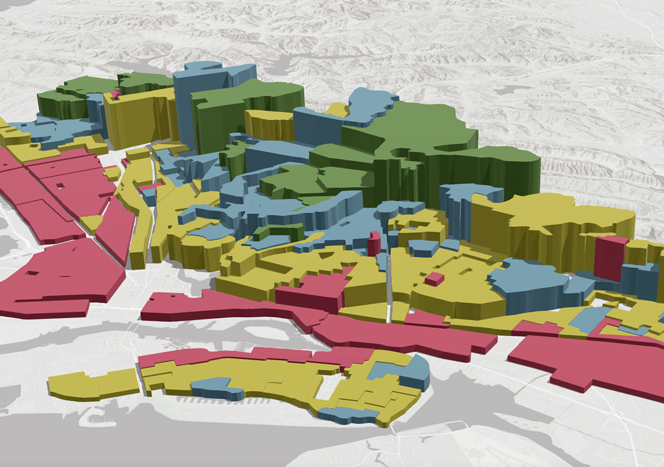
Visualizing and Mapping
Visualization and mapping involve displaying spatial data on a map, allowing users to interpret patterns, relationships, and trends across geographic areas.
Notes:
Explanation: Visualization and mapping involve displaying spatial data on a map, allowing users to interpret patterns, relationships, and trends across geographic areas.
How to Do It: Utilize GIS software to import spatial data, apply various map layers, and use symbols and colors to differentiate data features. Interactive maps may also include zoom, pan, and filter functionalities for detailed examination.
Primary Takeaways: Effective visualization transforms raw data into easily understandable maps, highlighting significant spatial insights and guiding decision-making processes.
Common Challenges: Overcoming data complexity and ensuring maps are user-friendly. Balancing detail with clarity to avoid overwhelming users with too much information at once.

Slide 22
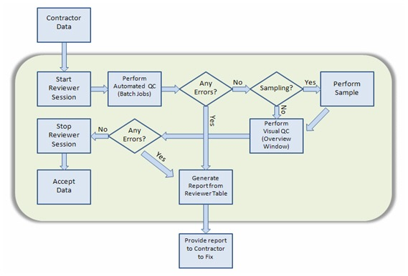
QA/QC
QA/QC refers to the processes used to ensure the accuracy and reliability of spatial data through systematic checks and validation techniques.
Notes:
Explanation: QA/QC refers to the processes used to ensure the accuracy and reliability of spatial data through systematic checks and validation techniques.
How to Do It: Implement checks at various stages of data collection and entry, such as verifying data against known standards, using automated tools to detect anomalies, and manually reviewing data for errors.
Primary Takeaways: QA/QC is essential for maintaining high-quality geospatial data, reducing errors, and ensuring that analyses and decisions based on the data are sound.
Common Challenges: Identifying and correcting errors in large datasets, and establishing comprehensive QA/QC protocols that cover all aspects of data handling.

Slide 23
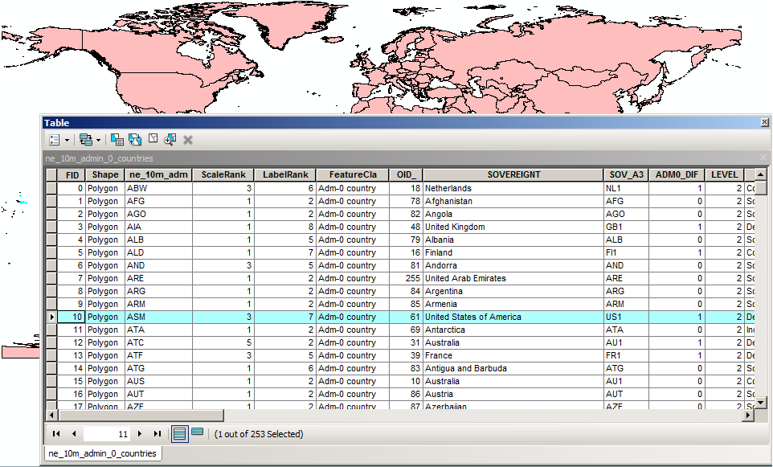
Tabular Data
Viewing tabular data involves examining the attribute information associated with spatial features in a table format, providing insight into the characteristics of the data.
Notes:
Explanation: Viewing tabular data involves examining the attribute information associated with spatial features in a table format, providing insight into the characteristics of the data.
How to Do It: In GIS software, attribute tables are accessed to view and analyze data related to spatial features. Users can sort, filter, and query the data to find specific information or identify patterns.
Primary Takeaways: Tabular data is crucial for understanding the details behind map features, enabling more in-depth analysis and supporting effective data management.
Common Challenges: Managing large datasets with complex attributes and ensuring the integrity of data relationships when filtering or querying tables.

Slide 24
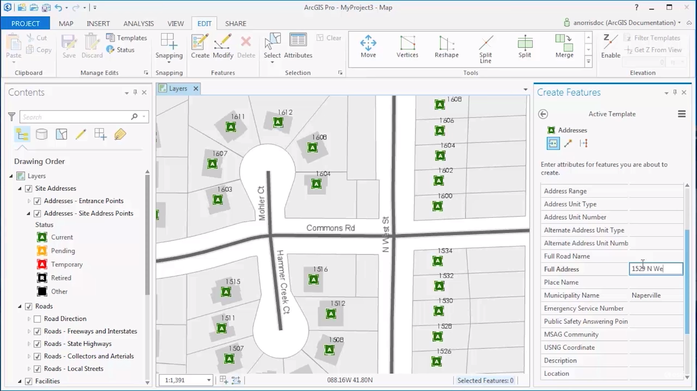
Create, edit, & delete Data
Editing spatial data involves modifying the geometry (location, shape) or attributes (information) of spatial features within a dataset.
Notes:
Editing Spatial Data
Explanation: Editing spatial data involves modifying the geometry (location, shape) or attributes (information) of spatial features within a dataset.
How to Do It: Use GIS software's editing tools to add, delete, or alter features. This can include changing the boundaries of a polygon, updating the position of a point, or editing the attributes in a feature's table.
Primary Takeaways: Editing is a fundamental aspect of GIS data management, allowing for the correction of errors, updates based on new information, and customization of datasets for specific needs.
Common Challenges: Ensuring edits are accurate and do not compromise data integrity. Managing version control when multiple users are editing the same dataset.

Slide 25
Live Demo
Notes:
Map the points, fix the nulls, delete some records, edit some records, find null island, make it look pretty

Slide 26
Spatial analysis
What is Spatial Analysis?
Types of Spatial Analysis
Displaying Results of Analysis
Enriching Analysis
Aggregating and Clustering and Heat Maps, Etc.

Slide 27
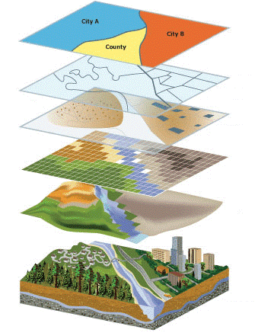
What is spatial analysis?
Spatial analysis is the process of examining the locations, attributes, and relationships of features in spatial data, through various techniques, to understand patterns, trends, and conditions in geographic space.
Notes:
Explanation: Spatial analysis is the process of examining the locations, attributes, and relationships of features in spatial data, through various techniques, to understand patterns, trends, and conditions in geographic space.
How to Do It: Utilize GIS software tools and methods to manipulate, extract, locate, and analyze geographic data. This includes overlaying datasets, conducting proximity analysis, and using statistical methods to explore spatial relationships.
Primary Takeaways: Enables the transformation of raw spatial data into valuable insights, supporting decision-making, policy development, and scientific research.
Common Challenges: Managing complex and large datasets, ensuring data accuracy, and selecting appropriate analysis techniques for specific research questions or problems.

Slide 28
Types of Spatial analysis
Spatial analysis encompasses a wide range of techniques, each suited to different types of data and research questions.
Examples:
Buffer Analysis: Creates zones around spatial features to evaluate proximity.
Overlay Analysis: Combines multiple data layers to identify relationships.
Network Analysis: Examines paths, routes, and networks for optimal routing and connectivity studies.
Spatial Interpolation: Estimates values for unsampled areas based on values from known locations.
Notes:
Explanation: Spatial analysis encompasses a wide range of techniques, each suited to different types of data and research questions.
Examples:
Buffer Analysis: Creates zones around spatial features to evaluate proximity.
Overlay Analysis: Combines multiple data layers to identify relationships.
Network Analysis: Examines paths, routes, and networks for optimal routing and connectivity studies.
Spatial Interpolation: Estimates values for unsampled areas based on values from known locations.
Primary Takeaways: The choice of analysis type depends on the objectives of the study and the nature of the spatial data.
Common Challenges: Each analysis type requires understanding of specific methodological considerations and data requirements.

Slide 29
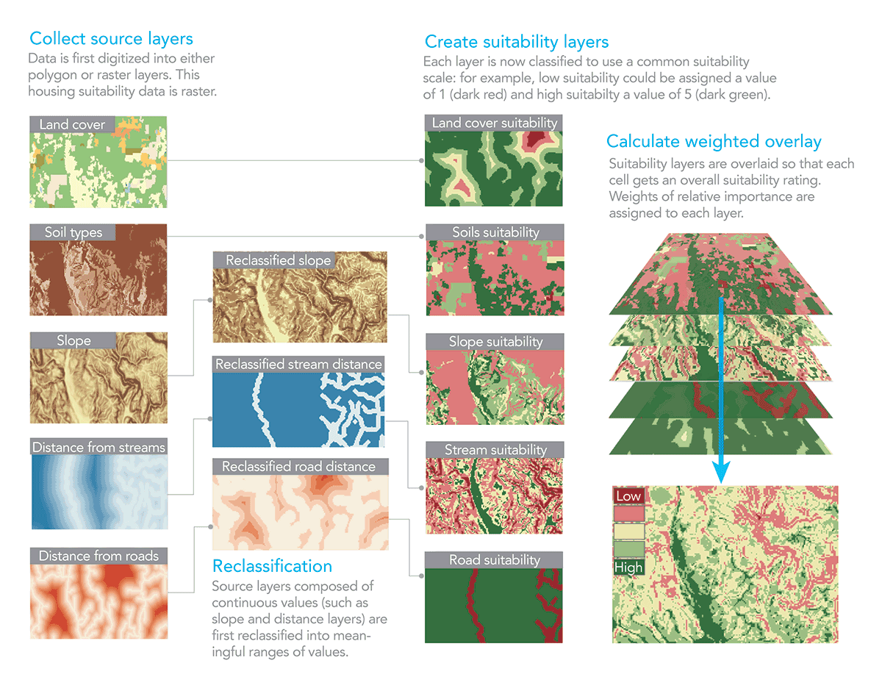
Displaying results of analysis
Effectively displaying the results of spatial analysis is crucial for communicating findings, making informed decisions, and guiding further research.
Notes:
Explanation: Effectively displaying the results of spatial analysis is crucial for communicating findings, making informed decisions, and guiding further research.
How to Do It: Use GIS software to create maps and visualizations that highlight the results of spatial analyses. This can include thematic maps, 3D visualizations, and interactive web maps.
Primary Takeaways: Visual representations make complex spatial relationships and patterns understandable and accessible to a broad audience.
Common Challenges: Designing visualizations that are both informative and engaging, while avoiding misinterpretation of the data.

Slide 30






Enriching analysis
Enriching analysis involves integrating additional data sources or layers to add context and depth to spatial analysis, enhancing the understanding of geographic phenomena.
Demographic Variables
Notes:
Explanation: Enriching analysis involves integrating additional data sources or layers to add context and depth to spatial analysis, enhancing the understanding of geographic phenomena.
How to Do It: Incorporate demographic, environmental, social, or economic datasets into your analysis to provide a more comprehensive view of the area of interest.
Primary Takeaways: Additional data layers can reveal new insights and relationships, leading to more informed conclusions and recommendations.
Common Challenges: Finding relevant and reliable data sources and ensuring compatibility between different datasets.

Slide 31
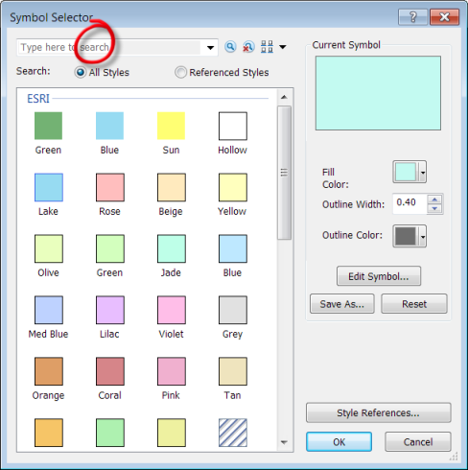
Improving symbology
Symbology refers to the use of symbols, colors, and styles to represent different types of spatial data on a map, enhancing the map's readability and interpretability.
Notes:
Explanation: Symbology refers to the use of symbols, colors, and styles to represent different types of spatial data on a map, enhancing the map's readability and interpretability.
How to Do It: Customize the appearance of data layers in GIS software by adjusting symbol types, colors, sizes, and transparency based on the data's characteristics and the map's purpose.
Primary Takeaways: Thoughtful symbology makes maps more intuitive and informative, highlighting key themes and making it easier for users to derive insights from the data.
Common Challenges: Choosing symbology that effectively communicates the intended message without misrepresenting the data. Balancing aesthetic appeal with functional clarity.

Slide 32
Visualizing Analysis
These techniques are used to summarize and visualize complex data, highlighting patterns of concentration, distribution, and intensity across geographic areas.
Aggregation: Grouping spatial data into larger units (e.g., census tracts) to simplify analysis and visualization.
Clustering: Identifying areas where spatial features are concentrated, often to detect patterns of interest or outliers.
Heat Maps: Visualizing data density or intensity, with colors representing the concentration of features or values in an area.
Notes:
Explanation: These techniques are used to summarize and visualize complex data, highlighting patterns of concentration, distribution, and intensity across geographic areas.
How to Do It:
Aggregation: Grouping spatial data into larger units (e.g., census tracts) to simplify analysis and visualization.
Clustering: Identifying areas where spatial features are concentrated, often to detect patterns of interest or outliers.
Heat Maps: Visualizing data density or intensity, with colors representing the concentration of features or values in an area.
Primary Takeaways: These methods help in understanding spatial phenomena at different scales and in identifying areas of interest for further investigation or action.
Common Challenges: Choosing the right method for the data and research questions, and accurately interpreting the results to avoid misleading conclusions.

Slide 33
Visualization - Live Demo

Slide 34
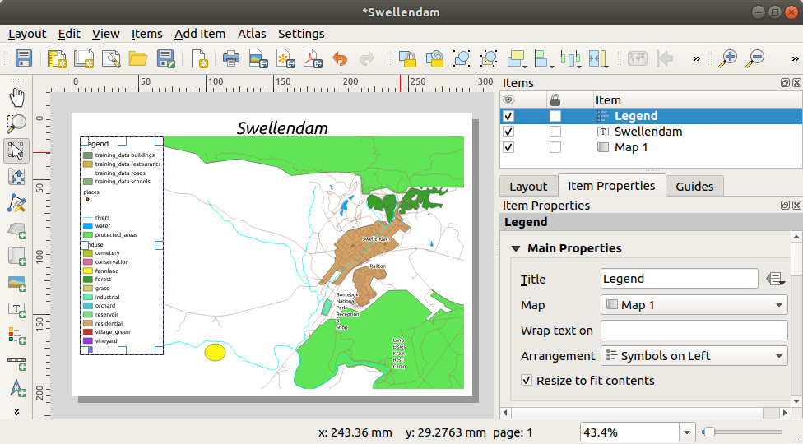
Sharing results
Enhances Understanding and Engagement
Supports Evidence-Based Decision Making
Encourages Collaboration and Feedback
Notes:
Sharing the results of GIS analysis with stakeholders through well-designed map layouts is a crucial step in the geographic information process. This practice not only communicates findings effectively but also facilitates informed decision-making and collaborative action. Here are detailed points on the importance of this process:
### Enhances Understanding and Engagement
- **Explanation:** Clear, visually appealing map layouts help translate complex spatial data into understandable information for stakeholders, enhancing their engagement and comprehension of the findings.
- **Impact:** Increased stakeholder understanding leads to more effective discussions, better decision-making, and stronger support for proposed actions or policies.
### Supports Evidence-Based Decision Making
- **Explanation:** Map layouts that effectively display analysis results provide a strong evidence base for decision-making processes, showcasing spatial patterns and insights derived from the data.
- **Impact:** Stakeholders can make informed decisions grounded in empirical data, reducing reliance on assumptions or anecdotal evidence.
### Facilitates Clear Communication
- **Explanation:** Well-designed maps can convey messages more clearly and concisely than text-heavy reports, making them powerful tools for communication.
- **Impact:** Effective visual communication ensures that key findings and messages are easily accessible and understandable to all stakeholders, regardless of their technical background.
### Encourages Collaboration and Feedback
- **Explanation:** Sharing map layouts with stakeholders invites feedback and fosters a collaborative environment, where different perspectives and insights can be integrated into the analysis and decision-making process.
- **Impact:** This collaborative approach can lead to more robust, community-supported solutions and strategies.
### Promotes Transparency and Trust
- **Explanation:** By openly sharing analysis results through map layouts, GIS professionals demonstrate transparency in their work processes and findings.
- **Impact:** Transparency builds trust among stakeholders, as it shows that decisions are made based on objective, visualized data rather than hidden agendas.
### Tailors Information to Different Audiences
- **Explanation:** Map layouts can be customized to highlight different aspects of the data, according to the interests and needs of various stakeholder groups.
- **Impact:** Tailoring information in this way ensures that each group receives relevant, actionable insights, maximizing the utility and impact of the shared results.
### Demonstrates Professionalism and Expertise
- **Explanation:** High-quality map layouts reflect the professionalism and expertise of the GIS team, showcasing their ability to analyze complex data and present it in an accessible format.
- **Impact:** Professional presentation of results can enhance the reputation and credibility of the GIS team, leading to greater influence and more opportunities for future collaboration.
In summary, sharing GIS analysis results through well-crafted map layouts is fundamental to bridging the gap between complex spatial data and actionable insights, fostering a productive dialogue among all stakeholders involved.

Slide 35
Sharing Results - Live Demo

Slide 36
Additional Materials
QGIS
Additional trainings - https://docs.qgis.org/2.18/en/docs/index.html
User Guide - https://docs.qgis.org/3.16/en/docs/user_manual/index.html
Duke University - https://guides.library.duke.edu/QGIS
Stack exchange - https://gis.stackexchange.com/

Slide 37
Additional Materials
R
Geocomputation with R - https://bookdown.org/robinlovelace/geocompr/
Spatial Statistics for Data Science: Theory and Practice with R (Advanced Analysis) – http://www.paulamoraga.com/book-spatial/index.html
Python
Introduction to PythonGIS - https://automating-gis-processes.github.io/2016/Lesson1-Intro-Python-GIS.html
PyQGIS (Python & QGIS together) - https://docs.qgis.org/3.28/en/docs/pyqgis_developer_cookbook/index.html

Slide 38
Thank You!
Jamie Parr
Data Analyst Consultant
Jamie_Parr@icf.com

Slide 39











U.S. Government Partners
Notes:
Please include this slide in your presentation in the appropriate location. Notes: Feed the Future connects U.S. Government efforts targeted at global hunger and food security. Led by USAID, Feed the Future draws on the resources and expertise of the U.S. Departments of Agriculture, Commerce, State and Treasury; the Millennium Challenge Corporation; the United States African Development Foundation; the Peace Corps; the Overseas Private Investment Corporation; the Office of the United States Trade Representative; and the U.S. Geological Survey.

